Slide 1


The Effect of Alcohol Consumption on Student Grades
Vanessa Tang
November 26, 2019
December 3, 2019

Slide 2
Research Questions
What factors are the strongest predictors of overall student grades?
How does alcohol consumption affect overall student grades?
What other interesting variables affect or surprisingly don’t affect student grades?

Slide 3
Data
1,044 students with 50 variables
Demographic information
Age
Sex
Urban/rural address
Family size
Parent’s information
Education level
Occupation
Academic information
Study time
Extracurriculars
Free time
Extra classes
Absences
Failures
Social information
Go out
Daily and weekly alcohol consumption
Relationship status
Travel time to school
Family relationship
Family support
Notes:
https://www.kaggle.com/uciml/student-alcohol-consumption#student-mat.csv

Slide 4
EDA: Overall Grade

Slide 5
EDA: Parent’s Education
Notes:
Medu - mother's education (numeric: 0 - none, 1 - primary education (4th grade), 2 – 5th to 9th grade, 3 – secondary education or 4 – higher education)

Slide 6
EDA: Weekly Study Time
1: <2 hours (317)
2: 2 to 5 hours (503)
3: 5 to 10 hours (162)
4: >10 hours (62)

Slide 7
EDA: Class Failures
0: 861
1: 120
2: 33
3: 30

Slide 8
EDA: Higher Education
0: 89
1: 955

Slide 9
EDA: Internet and Address

Slide 10
EDA: Alcohol Consumption

Slide 11
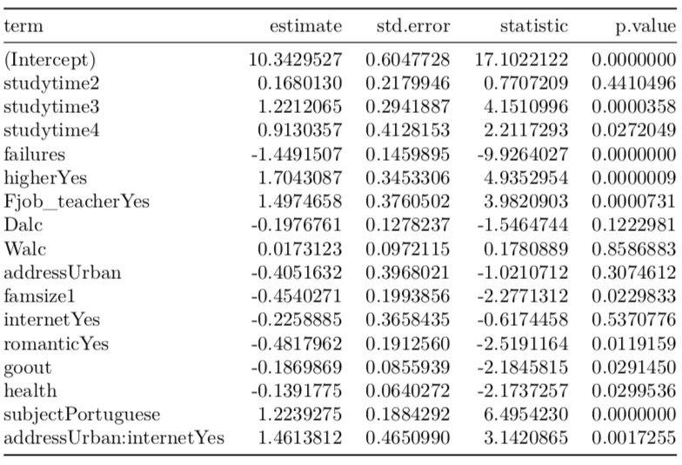
Linear Regression
R² = 25.79%
RMSE = 2.86
overall_grade_{i} = β₀ + β₁studytime + β₂failures + β₃higher + β₄Mjob_teacher + β₅Fjob_teacher + β₆Dalc + β₇Walc + β₈address + β₉famsize + β₁₀internet + β₁₁romantic + β₁₂goout + β₁₃health + β₁₄subject + β₁₅address:internet + ϵ_{i}

Slide 12
Results
Number of failures
Decrease 1.45
Striving for higher education
Increase 1.70
What factors are the strongest predictors of overall student grades?

Slide 13
Results
Daily alcohol consumption
Decreased 1.55
Weekly alcohol consumption
Increase 0.17
How does alcohol consumption affect overall student grades?

Slide 14
Results
Father is a teacher
Increase 1.50
Number of siblings is greater than or equal to 3 people
Decrease 0.45
In a romantic relationship
Decrease 0.48
1 level increase in the amount a student goes out
Decrease 0.19
1 level increase in health rating (5 = very healthy)
Decrease 0.14
Interaction between urban address and internet access at home
Increase 1.46

Slide 15
Appendix

Slide 16
Decision Tree
RMSE = 2.90

Slide 17
EDA: Subject
Math: 395
Portuguese: 649

Slide 18
EDA: Age
15: 194
16: 281
17: 277
18: 222
19: 56
20: 9
21: 3
22: 2

Slide 19
EDA: Extra Educational Support
No: 925
Yes: 119

